Slide 1

Performance Partnership
Driving University Performance
Syracuse University
Office of Human Resources
March 2015
performance.syr.edu

Slide 2


Your HR Performance Partnership Team
Karen Morrissey, HR Sponsor
Pamela Socker, Team Lead
Team Members and Presenters:
Amanda Barbuto
Lisa Brennan
Amanda Cooper
Camille Donabella
Pamela Gavenda
Monica Hobika
Paula MacDonald
James Schock
JoAnne Wallingford

Slide 3
Today’s Objectives
  Talent Management
  Performance Partnership Redesign
  Process and Timeline
  Streamlined Forms
  Paperless & Automated Data Collection
  Supporting Resources
  Phase II

Slide 4
Why are Performance Reviews Necessary?
Academic Strategic Plan
Unit Goals
Staff Goals
University Performance

Slide 5
Talent Management
The People Processes: Our Commitment to Attract, Recruit, Develop Exceptional Talent
Talent Review
Recruitment and Selection
Training and Development
Performance Management
Compensation and Rewards
Succession Planning

Slide 6
Talent Management
The People Processes: Our Commitment to Attract, Recruit, Develop Exceptional Talent
Talent Review
Recruitment and Selection
Training and Development
Performance Management
Compensation and Rewards
Succession Planning

Slide 7
Talent Management
The People Processes: Our Commitment to Attract, Recruit, Develop Exceptional Talent
Talent Review
Recruitment and Selection
Training and Development
Performance Management
Compensation and Rewards
Succession Planning

Slide 8
Talent Management
The People Processes: Our Commitment to Attract, Recruit, Develop Exceptional Talent
Talent Review
Recruitment and Selection
Training and Development
Performance Management
Compensation and Rewards
Succession Planning

Slide 9
Performance Partnership Cycle
Set Goals
Monitor and Coach
Re-Evaluate Goals
Assess Performance

Slide 10
Where Are We?
Set Goals
Monitor and Coach
Re-Evaluate Goals
Assess Performance

Slide 11
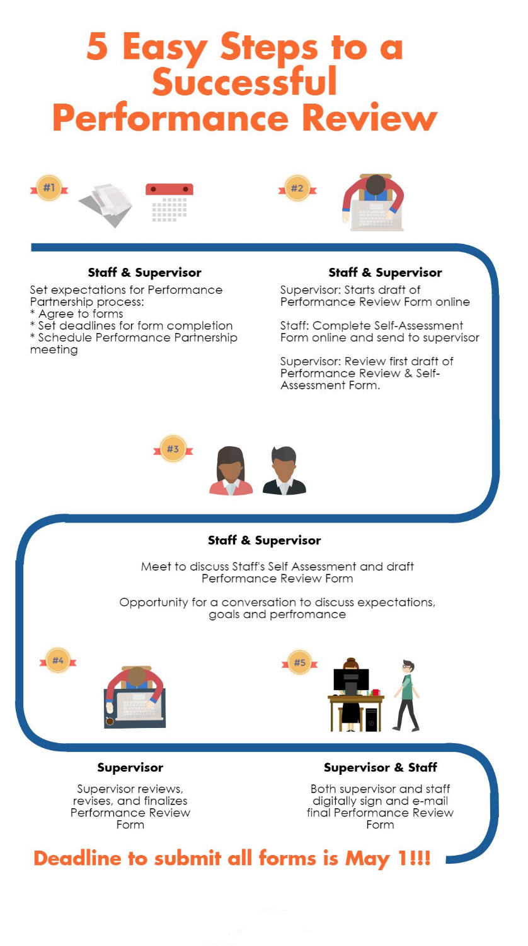
Performance Partnership Process and Timeline
Tools available on the web site to support the performance conversation

Slide 12

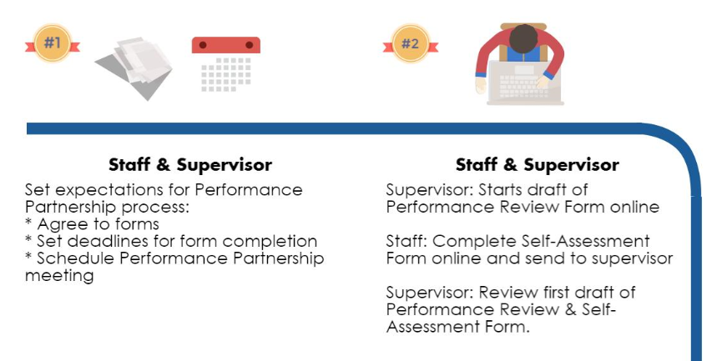
Performance Partnership Process and Timeline

Slide 13
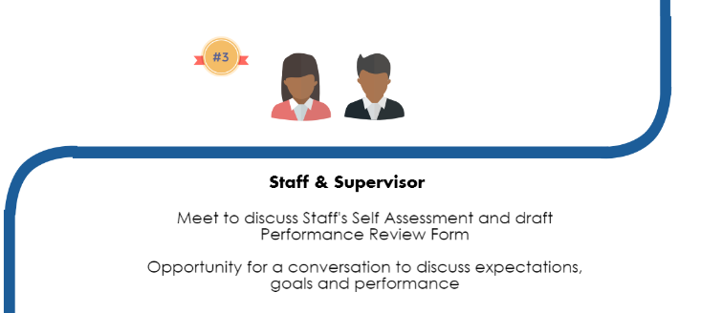
Performance Partnership Process and Timeline

Slide 14
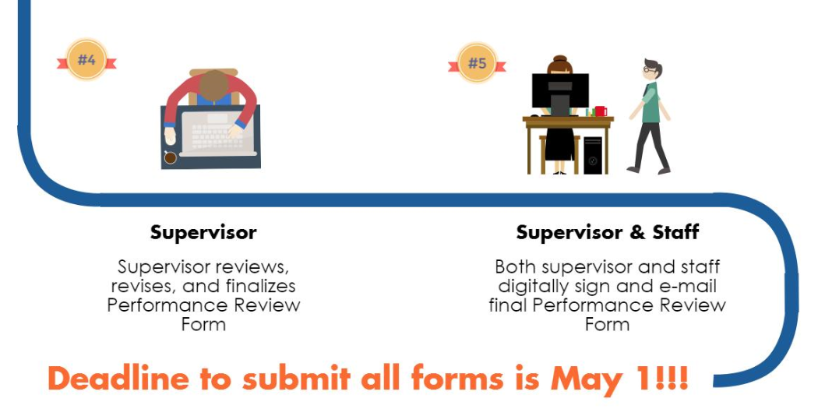
Performance Partnership Process and Timeline

Slide 15
The Forms
Similar Information…Serve Different Purpose
SYRACUSE UNIVERSITY OFFICE OF HUMAN RESOURCES
PERFORMANCE PARTNERSHIP FORM
SYRACUSE UNIVERSITY OFFICE OF HUMAN RESOURCES
PERFORMANCE PARTNERSHIP FORM Self-Assessment
4 Sections
Position Responsibilities
Performance Evaluation
Goals and Objectives future
Signatures
4 Sections
Position Responsibilities
Performance Evaluation
Goals and Objectives future
Signature

Slide 16
SYRACUSE UNIVERSITY OFFICE OF HUMAN RESOURCES
PERFORMANCE PARTNERSHIP FORM
Section 1: Position Responsibilities
Position Evaluation Request, PER
Clarity of Purpose
Like Job Families
Career Development
Reference when Evaluating Performance and Defining Goals
1x This Year

Slide 17
Title | Major Responsibilities | Competencies / Behaviors
Budget Administrator- S4 | Provide support, including the preparation of monthly financial analysis detail and summaries. Ongoing communication regarding the respective financial/budgetary operations. Analyze and compile financial data from online reporting systems. Administer and monitor department budget Reconcile corporate credit cards, travel vouchers, purchase requisitions etc. Enter semimonthly and weekly payroll records for department. | Collaboration Discernment/Judgment Planning and Organizing Problem Solving Technical Expertise Attention to Detail
Budget Manager- S5 | Manages the administrative and operational budget for departments within the division. Independently makes strategic decisions and recommendations affecting planning, policies, practices and operations with regard to budgetary and financial matters. Responsibilities include authorized signatory for departments in the division. Produces monthly budgetary forecasting reports. Directs, advises and instructs departmental administrative personnel regarding operating budgets, general ledger reports, purchasing policies and office management procedures. | Coaching and Development Discernment/Judgment Organizational Understanding Problem Solving Team Leadership Attention to Detail
Budget Director- S6 | Manage budget of the designated division and monitor budget allocations, expenditures, fund balances and related financial activities. Ensure allocations are accurate, revenues are recorded, expenses are within budget and fiscal practices are followed. Create and analyze monthly financial statements for all units utilizing a variety of financial information (revenues, expenditures, projections). Make recommendations, maximize use of funds, and/or ensure overall operations are within budget. Prepare a wide range of materials including annual budgets, monthly financial statements, and regular reports for the Board of Trustees and department administrators. | Coaching and Development Discernment/Judgment Influence Organizational Understanding Team Leadership Attention to Detail
Job Family: Business and Finance

Slide 18
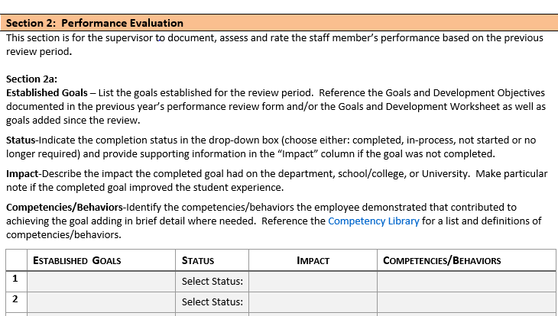
SYRACUSE UNIVERSITY OFFICE OF HUMAN RESOURCES
PERFORMANCE PARTNERSHIP FORM
Section 2: Performance Evaluation
Assessing Past Performance
(2a) Established Goals
(2b) Development/Opportunities for Improvement
(2c) Overall Performance Summary Rating
(2d) Supervisor’s Summary Comments
(2e) Staff Member’s Summary Comments

Slide 19
Section 2: Performance Evaluation
Behaviors/
Competencies
Accomplishments
Goals/Development Objectives
Position Responsibilities
School/College Department Goals
Academic Strategic Plan
Competencies/Behaviors drive the Successful Accomplishment of Goals and Development Objectives.
Goals and Development Objectives are aligned with:
  Position Responsibilities
  School/ College Department Goals
  The Academic Strategic Plan
Competency Library

Slide 20
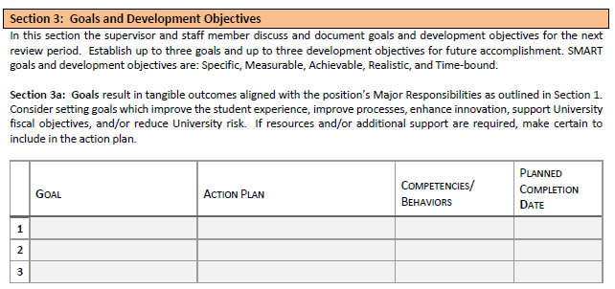
SYRACUSE UNIVERSITY OFFICE OF HUMAN RESOURCES
PERFORMANCE PARTNERSHIP FORM
Section 3 Goals and Development Objectives
Planning Future Performance
(3a) “SMART” Goals
(3b) Development Objectives

Slide 21
Goal Element | Definition
Specific | Detailed and Focused. Anyone reading the goal should know what is to be accomplished and how it will be completed.
Measurable | Quantifiable. Anyone reading the goal should be able to determine the intended result. When possible a measurable metric should be used.
Achievable | Realistic and Motivating. Goals should stretch the staff member slightly so they feel challenged. Careful review of competencies and behaviors leads to creating goals that can be successfully accomplished.
Relevant | Current and Pertinent. It is important to consider current department/ organizational objectives and related key responsibilities of the staff member’s position as the relevance of a goal is defined.
Time-bound | Define the time period in which the goal should be completed. Set the urgency and priority in this section.

Slide 22
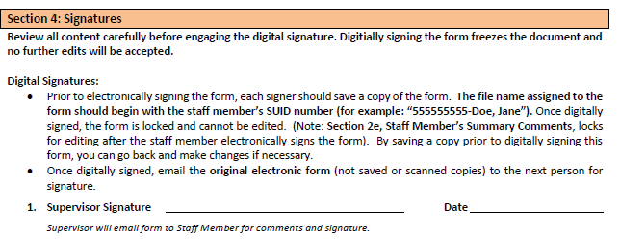
SYRACUSE UNIVERSITY OFFICE OF HUMAN RESOURCES
PERFORMANCE PARTNERSHIP FORM
Section 4 Signatures
Performance Partnership Has Gone GREEN
Digital signatures
Save copy prior to signing
Filename is Staff Member’s SUID # + Name
Email form to next person for signature
Final step – email completed form to Human Resources at performance@syr.edu

Slide 23

SYRACUSE UNIVERSITY OFFICE OF HUMAN RESOURCES
2015 PERFORMANCE PARTNERSHIP FORM-Self Assessment
What’s the Value?
Outcome: Fair and Equitable Performance Assessment
Staff Ownership = Motivation and Engagement

Slide 24
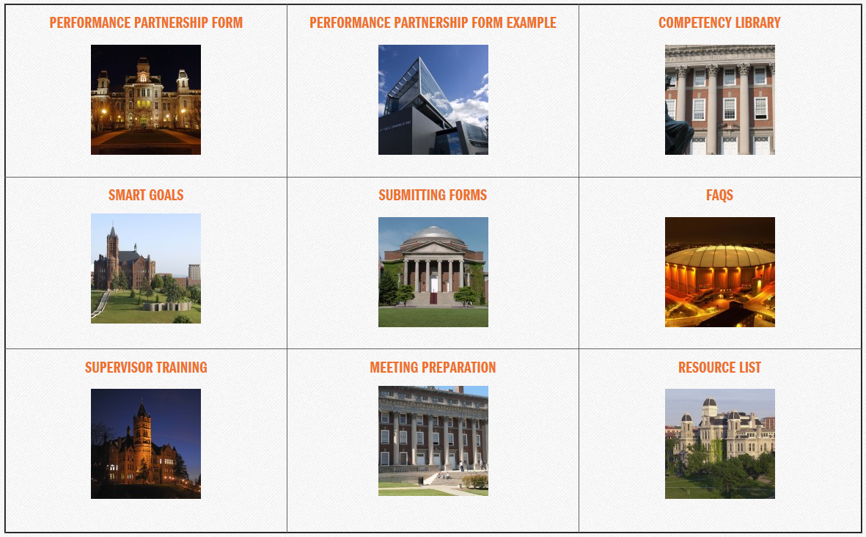
Supporting Resources
performance.syr.edu

Slide 25
Supporting Resources
HR at Your Service!
Performance Partnership Process | Pam Socker, Ext. 2349
Employee Relations | Pam Gavenda, Ext. 7612
Position Evaluation Request - PER | Amanda Cooper, Ext. 4824 Monica Hobika, Ext. 5731 (HRComp@syr.edu)

Slide 26
What’s Next?
Phase II
  Outcomes from Phase I
  Gather Campus Feedback
  Performance Cycle Review Period
  Resources and Support
  Forms
  Intuitive System to Improve Process Integration and Data Collection

Slide 27


